Slide 1
How Climate Change will Affect Saskatchewan
PARC REPORT 2013 SUMMARY

Slide 2
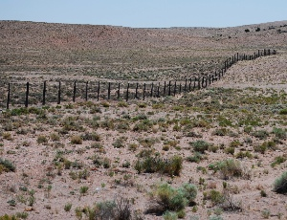
key findings from the report (p.3)
Increased water scarcity

Slide 3
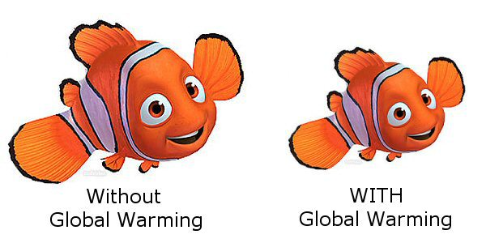
key findings from the report (p.3)
Significant ecosystem changes (invasive species, economic impacts ie. Agriculture, forestry, and aboriginal livelihood)

Slide 4
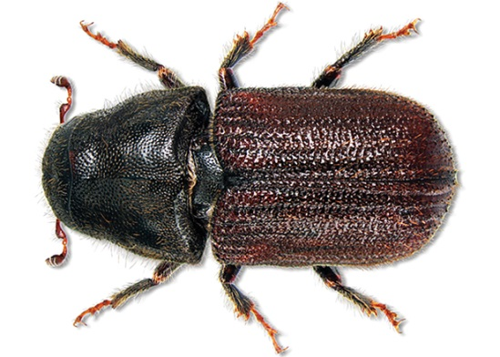
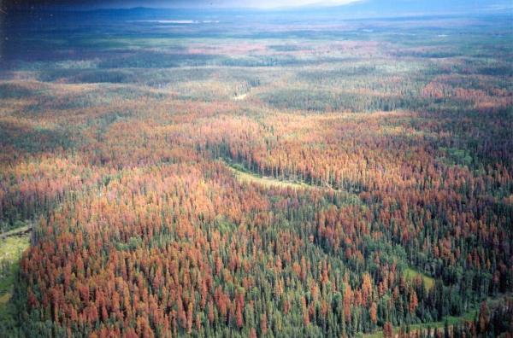
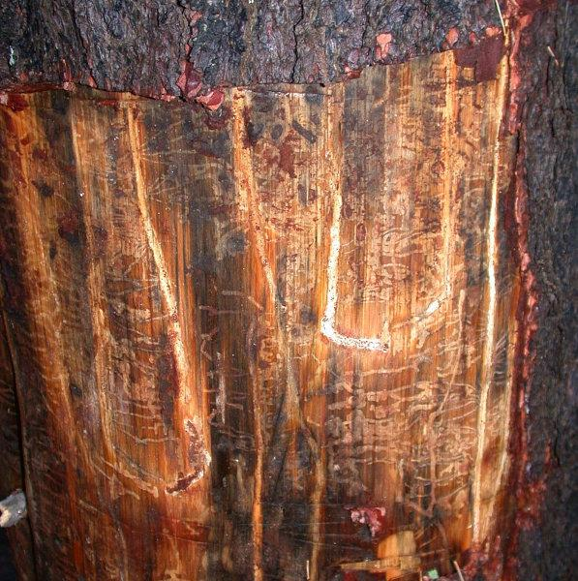
key findings from the report (p.3)
Lose advantages of cold winters (winters destroys pests, assists with forestry)

Slide 5
key findings from the report (p.3)
Adaptive capacity is unevenly distributed (the poor and rural will be hit harder)
Low-income countries will remain on the frontline of human-induced climate change over the next century, experiencing gradual sea-level rises, stronger cyclones, warmer days and nights, more unpredictable rains, and larger and longer heatwaves, according to the most thorough assessment of the issue yet
Oxfam predicted that world hunger would worsen as climate change inevitably hurt crop production and disrupted incomes. They suggested the number of people at risk of hunger might climb by 10% to 20% by 2050, with daily per-capita calorie availability falling across the world

Slide 6
What are the prairies like?
Ecozones
Watersheds
Population
Employment

Slide 7
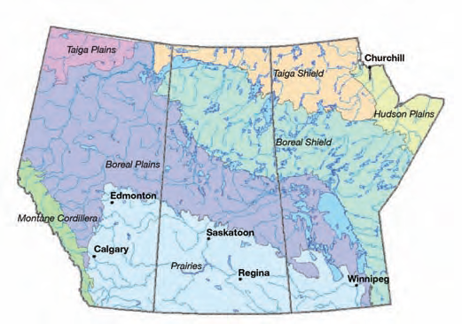
Ecozones (280 ff)

Slide 8
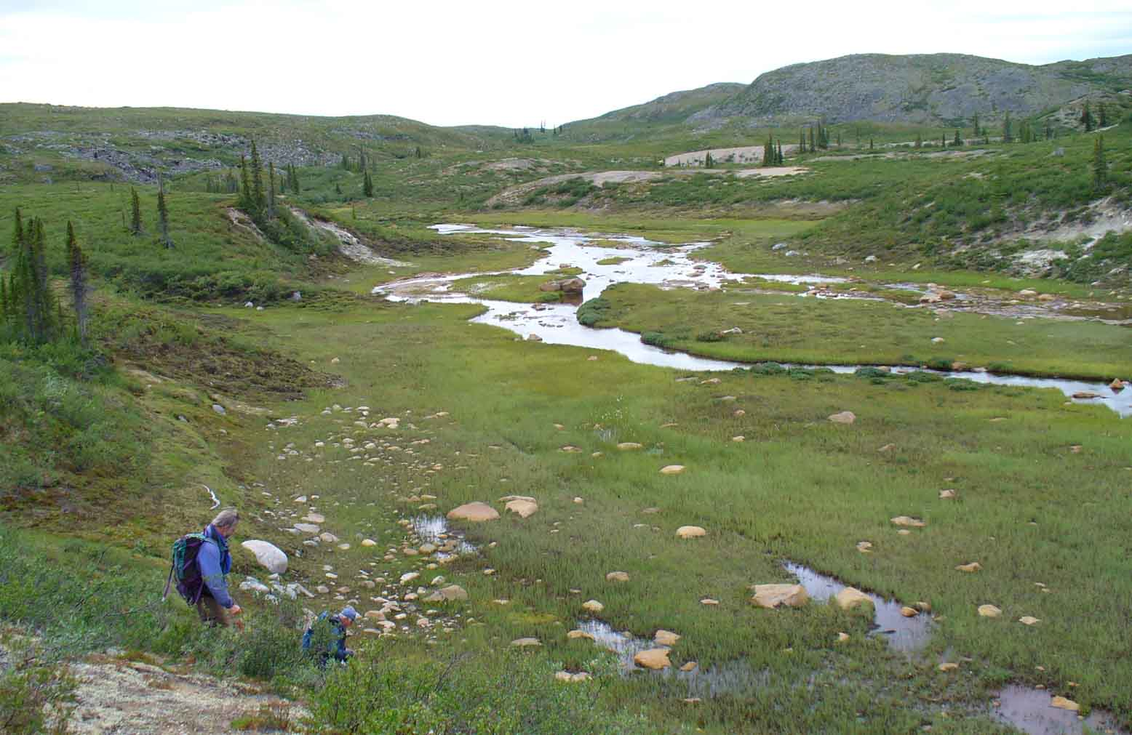
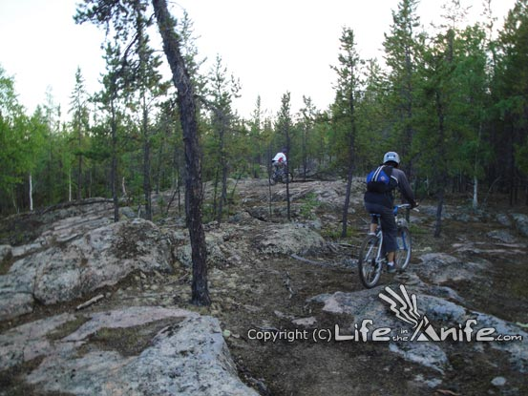
Taiga shield

Slide 9
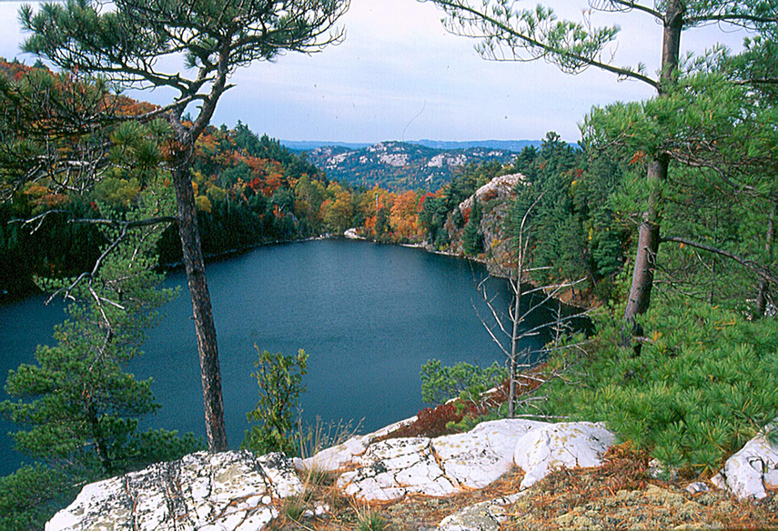
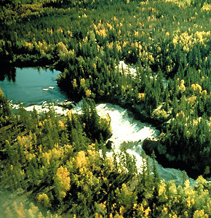
Boreal shield

Slide 10
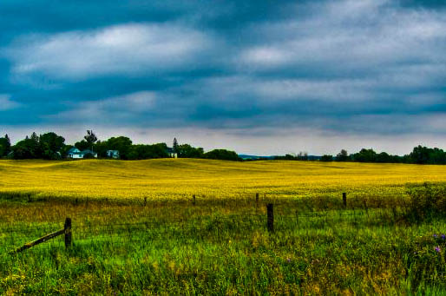
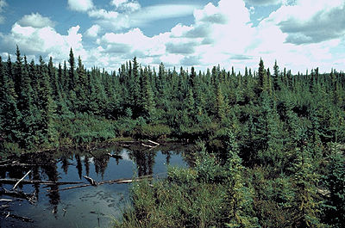
Boreal plains

Slide 11
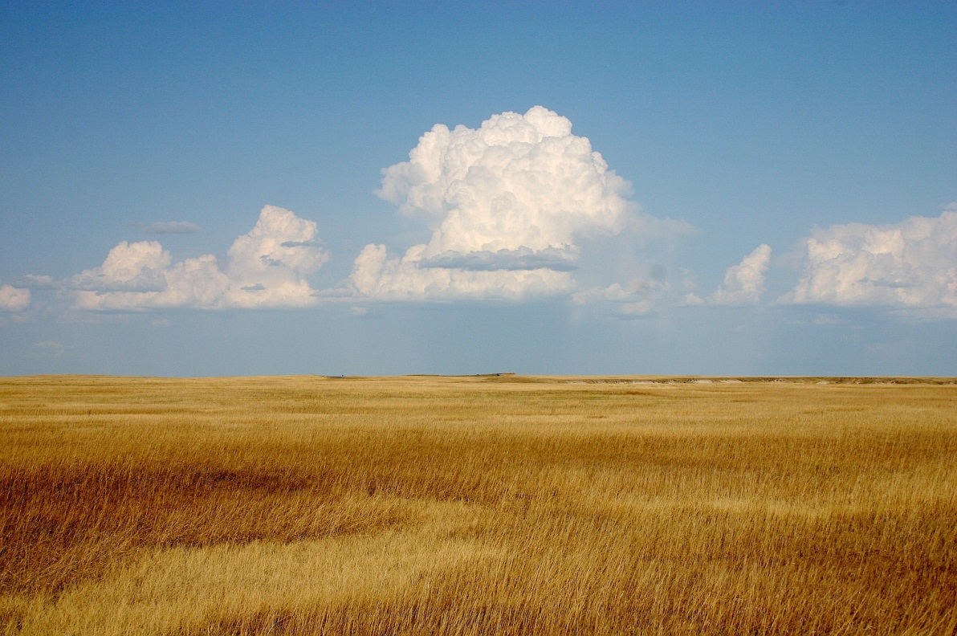
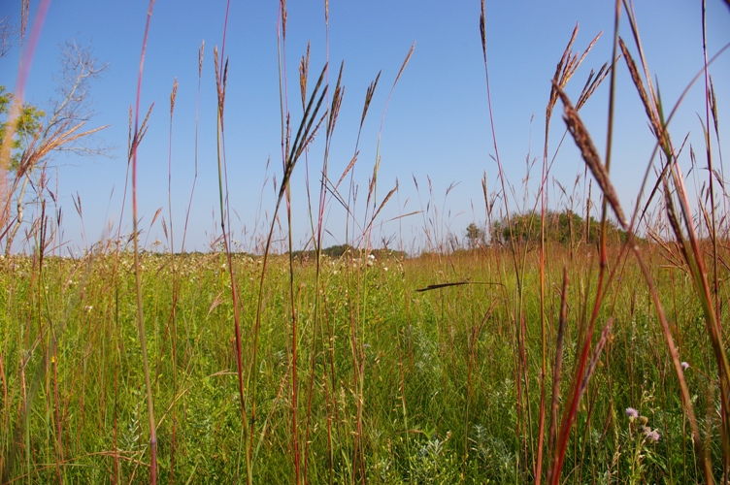
prairies

Slide 12
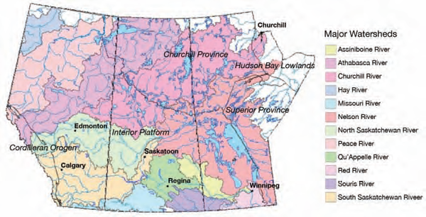
Major watersheds

Slide 13
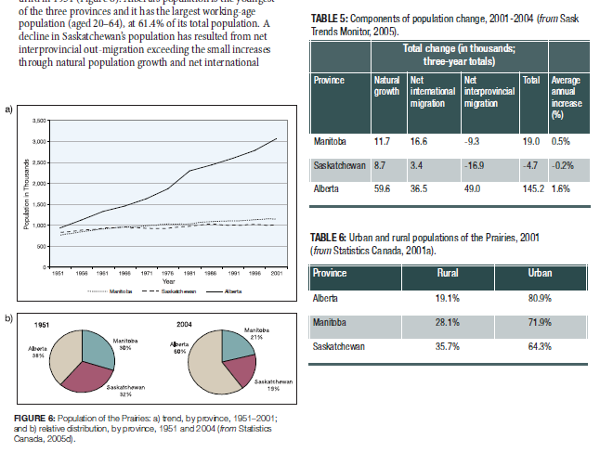
POPULATION CHANGES

Slide 14
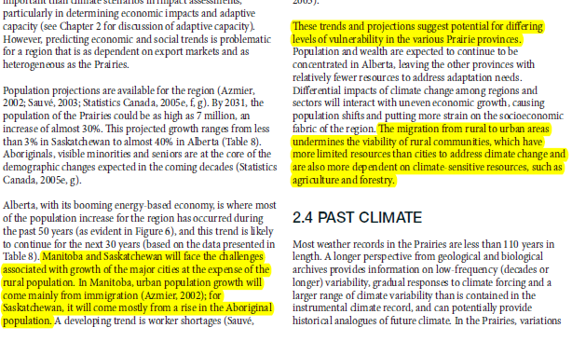
POPULATION TRENDS (284)

Slide 15
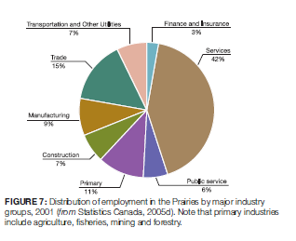
EMPLOYMENT DISTRIBUTION (283)

Slide 16
SUMMARY (288)
ANTICIPATED 8 DEGREE CHANGE IN COMPUTER MODELLED MEDIAN ACROSS SASKATCHEWAN BY 2080
ADAPTATIONS -290-294

Slide 17
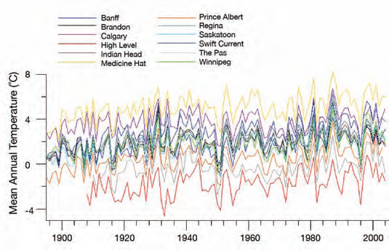
historical Temperature changes

Slide 18
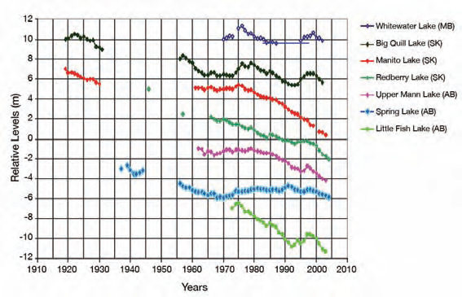
Historical Water levels

Slide 19
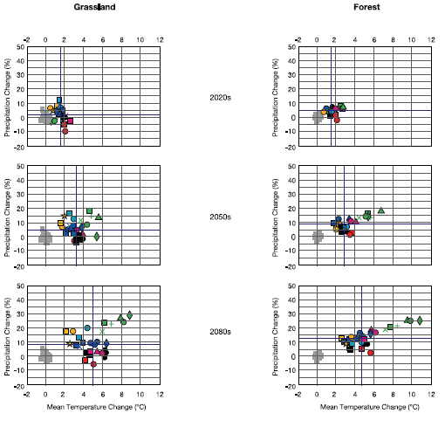
COMPUTER MODELS OF CLIMATE CHANGE

Slide 20
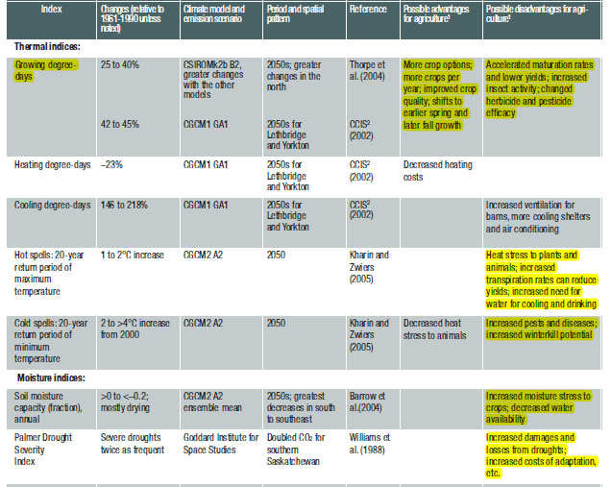
AGRICULTURE IMPACTS

Slide 21
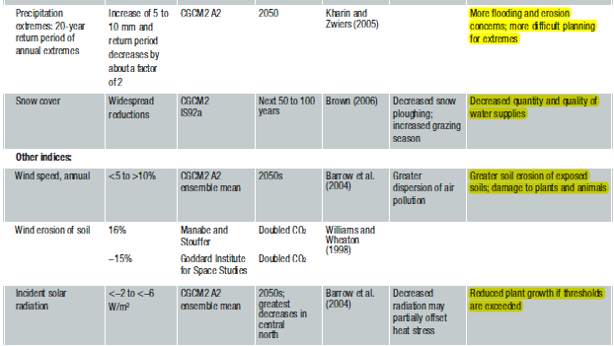
AGRICULTURE IMPACTS continued

Slide 22
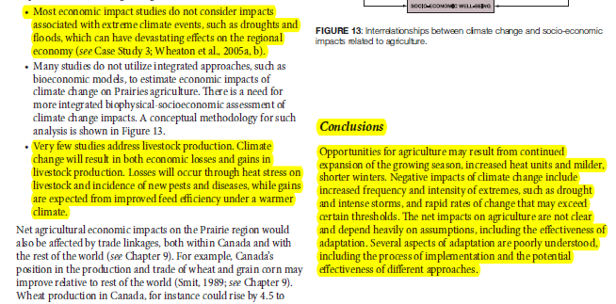
Agricultural impacts summary (300)

Slide 23
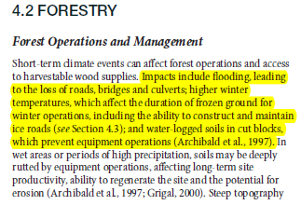
Forestry impacts (301)

Slide 24
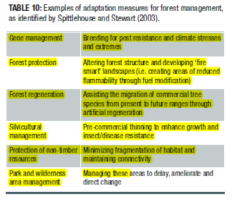
Forestry industry adaptations (302)

Slide 25
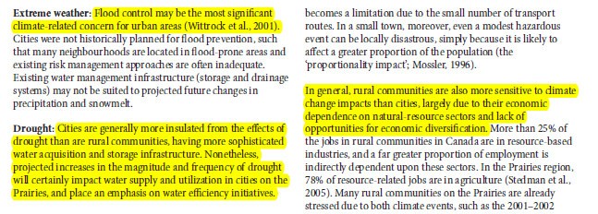
Impacts on communities (307)

Slide 26
Impacts on human health
Increase in Drought, flooding, vector borne diseases

Slide 27
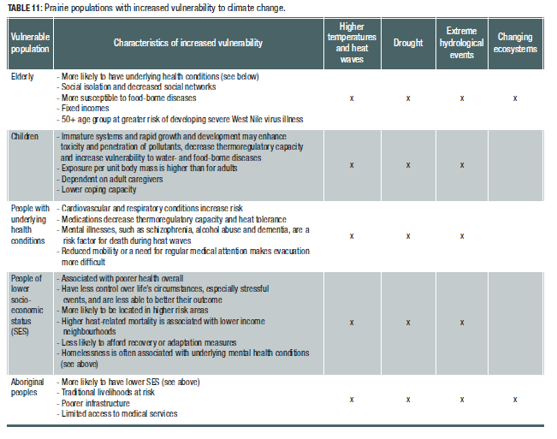

Slide 28
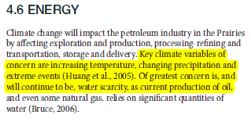
Energy industry

Slide 29
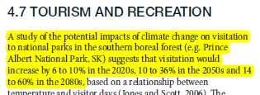
Tourism and recreation (313)

Slide 30
Synthesis (319-20)….you tell me what the most important points are

